Slide 1
Presenter Service
Lexi Circle and Taylor Hoult
Henry F. Moss Middle School

Slide 2
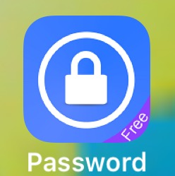
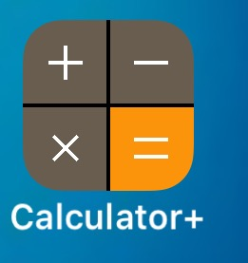
Hidden Apps
This project is to inform parents about apps their children may be hiding things in.
Examples of some of the secret apps your children may be using are:
At first glance, these apps may look like a calculator or games. You never know what your child may be hiding within these apps. What makes these apps suspicious? You either have to have a password, or make a account to use them.

Slide 3
Experience Presenting
Taylor’s Experience:
7 Habits Presentation: I picked a habit and presented a slide on a powerpoint with other students on the Lighthouse Team.
In my reading class, I had to design a book trailer and present the video to my class.
Also, in reading class I read a biography and designed an avatar using http://www.voki.com/ and presented it to my class.
Lexi’s Experience:
Social Media Night: A group of STLP students presented to parents, how to stay safe on social media and explained how a few different apps worked.
Holocaust Presentation: I worked with a group and created a presentation on how the Jews were treated during the Holocaust.
Welcome to Moss video: I created a “Welcome” video to present to our incoming 6th graders.

Slide 4
Other Information
Why did we choose to create a presentation on this topic?
We are trying to prevent/lower the amount of bullying within our school and community. You may think your child is safe while using their phone because the apps look like normal apps. If your child is using these apps for bullying you would never know. We are trying to inform parents of apps their children may be hiding on their devices and possibly what is within these hidden apps.

